Slide 1
The Reality of Human Trafficking
Global, National and Local Viewpoints

Slide 2
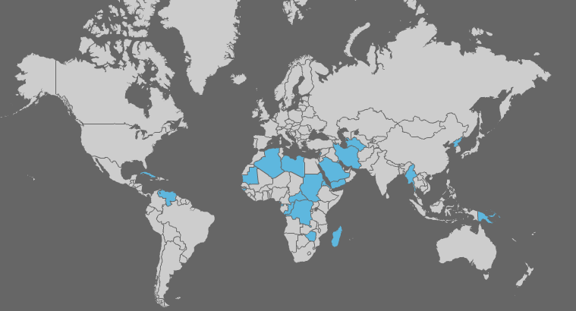
Global Issue
Tier 3 countries: Do not fully comply with minimum standards set by the US
(ammap.com, 2012)
Notes:
(Rogers, 2011)
Image: (Ammap.com, 2011)

Slide 3
Statistics
600,000 – 800,000 people are trafficked across international boarders annually
80% of human trafficking victims are female
50% of all trafficking victims are under the age of 18
Human trafficking is the third most profitable criminal activity
More than $9.5 billion generated annually through all trafficking activities
80% of all trafficking involves sex exploitation
19% of all trafficking involves labor exploitation
Notes:
(Human Trafficking Facts, n.d.)
Note: 3 most profitable following drugs and arms trafficking
$32-34 billion according to some references

Slide 4
Two Major Types of Human Trafficking
Sex Trafficking
Labor Trafficking
Force, fraud, or Coercion into sex industry
Exploitation, forced labor, or indentured servitude
(Google.com – image search “human trafficking”, 2012)
Notes:
(Human Trafficking Facts, n.d.)
Images: (google.com, 2012)
Note: Sex Industry = Prostitution, Dancing, Stripping, Modeling

Slide 5
Global View
161 countries are reported to be affected by human trafficking
(a source, transit or destination )
Notes:
(Human Trafficking: The Facts, n.d.)

Slide 6
Global Data
Sex Trafficking
Sex Industry revenue = $57+ billion annually
43% are victims of sexual exploitation
98 % are women and girls
Labor Trafficking
32% are victims of forced economic exploitation
56% are women and girls
Notes:
(Human Trafficking: The Facts, n.d.)

Slide 7
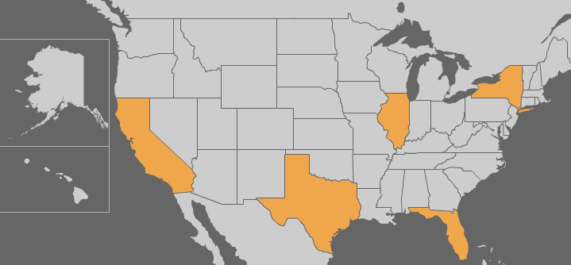
National View
(ammap.com, 2012)
Last year, nearly 50% of calls placed to NHTRC came from 5 states
Notes:
(Annual Report – 2011, 2012)
Image: (Ammap.com, 2012)

Slide 8
National Trend
NHTRC Number of Calls Received
NHTRC call volume by year
Call volume increased by 61% between 2010 & 2011
Notes:
(Annual Report – 2011, 2012)

Slide 9
National Data
Sex Trafficking
3,829 adult cabarets
Employs over 500,000
More strip clubs than any other nation
Strip clubs doubled between ‘87-’92
3,000 strip clubs in 1997
Labor Trafficking
40,000-50,000 men, women & children trafficked into the US each year
48% of calls into the NHTRC in 2011
Notes:
(Statistics on the Sex Industry, n.d.)
(Human Trafficking Facts, n.d.)
(Annual Report – 2011, 2012)

Slide 10
Local View – a snapshot
In 2011…
865 calls into NHTRC originated in Florida
  44 Tampa
  10 Clearwater
  15 St. Petersburg
  3 Dunedin
  3 Spring Hill
  2 Seminole
60 calls demonstrated key indicators of human trafficking occurrences
  2 Palm Harbor
  2 Largo
  2 Plant City
  1 Safety Harbor
  1 Land O Lakes
  1 Pinellas Park
Notes:
(Florida State Report: January 1st 2011 – December 31st 2011, 2012)

Slide 11
Local Data
Sex Trafficking
Tampa has the most sex-related businesses in the state, and the highest rate of human trafficking
8/20/12 – 81 Florida massage licenses suspended
6/2/12 – two women arrested in Hillsborough County
Labor Trafficking
Most prevalent form of human trafficking in the state of Florida
10/8/10 – 2 homes and 1 restaurant raided & 27 people questioned in Pinellas County
Notes:
(Young, 2010)
(Stockfisch, 2012)
(Thompson, 2010)
(TBO.com, 2012)

Slide 12
Local Findings
Survey conducted during Tampa Bay Healthcare Collaborative quarterly meeting
  24 participants
  22 unique organizations
  28+ collective years of experience in efforts against human trafficking

Slide 13
Survey Results
Human trafficking is a growing problem in the Tampa Bay community
The average person living in the Tampa Bay area is aware of human trafficking occurrences in their community

Slide 14
Survey Results (Cont.)
The local news media has done an adequate job reporting on the issue of human trafficking in Tampa Bay.
There are adequate support services for individuals impacted by human trafficking in the Tampa Bay area.

Slide 15
Long Term Impacts
65% of female sex trafficking victims sustain internal injuries, 24% sustain head injuries, 12% sustain broken bones
68% of female sex trafficking victims meet the clinical criteria for post-traumatic stress disorder
More than 2/3 of sex trafficked children experience additional abuse at the hands of their trafficker
Nearly 71% of sex trafficked children exhibit suicidal tendencies
Sex trafficked children are twice as likely to develop serious mental health problems. They are also more likely to abuse substances, engage in prostitution as adults, and commit or be victimized by violent crimes.
Notes:
(Human Trafficking Facts, n.d.)

Slide 16
Resources & Support Services
International
National
Eye Heart World
Shared Hope International
A21 Campaign
Not For Sale
National Human Trafficking Resource Center (NHTRC)
Safe Horizon
Immigration & Customs Enforcement (ICE)
Rescue1
Traffic Free
JEMS
Esther House

Slide 17
Local Resources & Support Services
Clearwater Task Force
Created
Rachel’s Project
Bridging Freedom
Redefining Refuge
World Relief Tampa
Center for Human Trafficking Awareness (SPC)

Slide 18
Thank you

Slide 19
References
Annual Report – 2011. (2012). Retrieved from: https://na4.salesforce.com/sfc/p/300000006E4S11Sv6mFa.D_CBl0UueofejFjNL0=
Florida State Report: January 1st 2011 – December 31st 2011. (2012). Retrieved from: https://na4.salesforce.com/sfc/p/300000006E4SzdGZ_AUctaTvZ3zuSGgCmCMmq84=
Human Trafficking Facts. (n.d.). Retrieved from: http://www.ncadv.org/files/HumanTrafficking.pdf
Human Trafficking: The Facts. (n.d). Retrieved from: http://www.unglobalcompact.org/docs/issues_doc/labour/Forced_labour/HUMAN_TRAFFICKING_-_THE_FACTS_-_final.pdf

Slide 20
References (cont.)
Rogers, Simon. (2011). Human Trafficking: How The US State Department Ranks Your Country. Retrieved from: http://www.guardian.co.uk/news/datablog/2011/jun/27/human-trafficking-us-state-department
Statistics on the Sex Industry. (n.d.) Retrieved from: http://www.createdwomen.com/
Stockfisch, Jerome. (2012). Massage therapist suspensions tied to human trafficking. Tampa Bay Times. Retrieved from: http://www2.tbo.com/news/news/2012/sep/20/namaino1-massage-therapist-suspensions-tied-to-hum-ar-506774/
TBO.com. (2012). Human Trafficking Arrests [Video]. Retrieved from: http://video.tbo.com/v/51584775/human-trafficking-arrests.htm?q=human+trafficking

Slide 21
References (cont.)
Thompson, Stephen. (2010). Feds conduct Pinellas raids in human trafficking probe. Tampa Bay Times. Retrieved from: http://www2.tbo.com/news/news/2010/dec/08/federal-agents-conduct-largo-raids-in-human-traffi-ar-25457/
Young, Sheryl. (2010). Human trafficking, sex slavery: Tampa has highest rates in Florida. Examiner. Retrieved from: http://www.examiner.com/article/human-trafficking-sex-slavery-tampa-has-highest-rates-florida

